Slide 1
Georgia Online IEP
Presented by:
Deborah Gay
Director, Division for Special Education
Travis Allen
Department of Technology Services
Linda Castellanos
Program Specialist for Compliance

Slide 2
Request from districts
A web-based IEP solution combining the power of Technology and the local Special Education departments throughout the state

Slide 3
Needed features
Real-time access to data
Easy to use
Reduce LEA paperwork
Improve services to children and families

Slide 4
Georgia Online IEP
Georgia obtained the Maryland Online IEP system at no cost as a building block
Modifications in the system customized the application for Georgia’s needs
Ready to pilot in districts

Slide 5
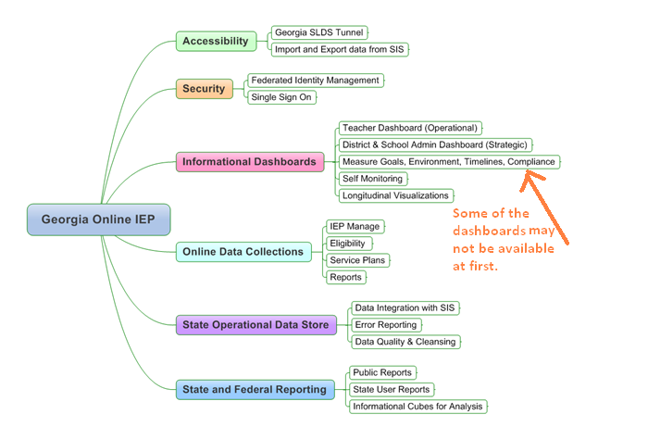
Features

Slide 6
Benefits to districts
Real-time access to student IEP data
Access any IEP record, any time
Access by multiple teachers and administrators based on access rights
Reports and indicator data readily available
Integrated with the SLDS system
IEP available when Georgia students change districts

Slide 7
Benefits to districts
Reduced burden & expense on LEA
Some reporting requirements automated
Inter-district transfers streamlined
State funded & supported

Slide 8
Benefits to districts
State and Federal Reporting:
Timeline data
IEP annual tracking
Student Record event dates reporting
Future plan: Federal Report now included in FTE 1

Slide 9
Benefits to districts
Better tools for managing IEPs
Built-in wizards simplify process
Provides support to teachers
State & IDEA compliant IEPs
Reports for tracking

Slide 10
Future enhancements
Links to district graduation requirements
Ability to check SPP AYP data
Access through the application for the CCGPS
Other enhancements suggested by piloting schools

Slide 11
Other advantages of GA Online IEP
Integrated with SLDS application
Rich dashboards
SLDS data availability
Local systems manage users’ access
Individualized user perspectives

Slide 12
Benefits to Teachers
Single Sign-on
Teacher-specific student view
Access to current and draft IEPs
Wizards help in creation of goals
Built-in forms
Auditing function ensures all required sections of IEP are complete

Slide 13
Other benefits
State sponsored and funded (free to districts!)
Seamless integration with Data Collections
Built-in edit checks to ensure data quality

Slide 14
20,000 foot view

Slide 15
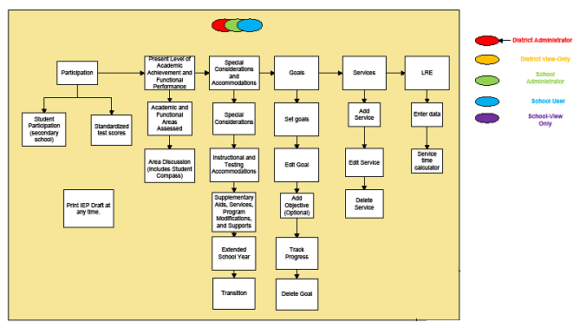
IEP Process

Slide 16
Finalizing an IEP

Slide 17
Why should we use Georgia Online IEP?
State-Sponsored
Access to Data
Opt -in, voluntary offering
Improvement in data reporting
Improved Special Ed IEP Support
State Funded
District-GADOE Connection
Aligns statewide data collection
Benefits all local districts
SLDS Integration
State Supported

Slide 18
Piloting School Districts
Coweta County
Dublin City
Jones County
Morgan County
Thomas County

Slide 19
Georgia Online IEP Milestones

Slide 20
Georgia Online IEP
Questions?

